Slide 1
Map

Slide 2
Map
Takes the form
map(function_to_apply, list_of_inputs)
Instead of iteration
items = [1, 2, 3, 4, 5]
squared = []
for i in items: squared.append(i**2)
squared = list(map(lambda x: x**2, items))

Slide 3
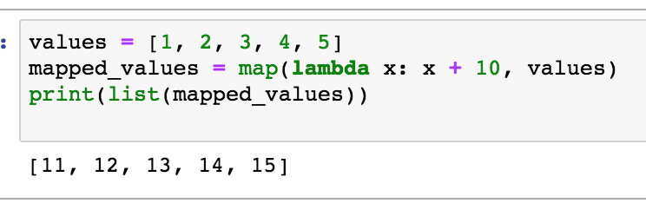
In line lambda expression

Slide 4
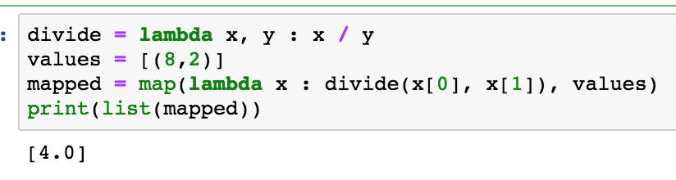
Another example – multiple arguments

Slide 5
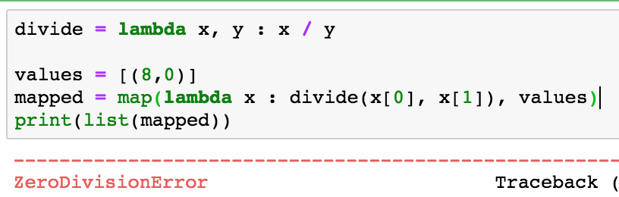
Handling the exception

Slide 6
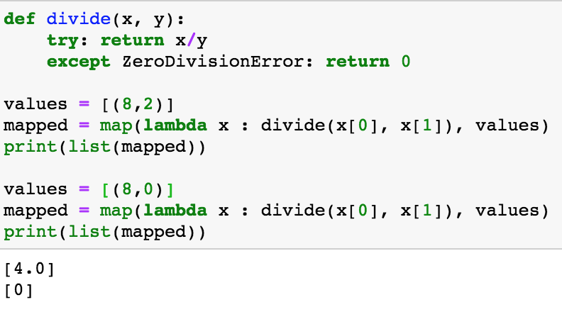
Use a def in this case

